Slide 1
OS - Linux Part 1
Malchiel Ed Urias
4.0

Slide 2
Content
1. What is an Operating System
2. Examples of OS
3. Functions of OS
4. Types of OS
5. OS Services
6. Linux
7. Linux Distributions
8. Linux Architecture
9. Linux File System
4.0

Slide 3
What is an OS
An Operating System is the most important software on a computer. It is the software on which every other software application on the computer runs. It also manages the computer’s resources like processor and memory
The Operating System acts as an interface and an intermediary between the computer user and the computer hardware and enables the uses run programs conveniently.
The Operating System is a collection of computer programs that manage the resources on the hardware and perform basic services like file system management, process management, memory management, handling input and output processes.
The software that contains the core components of an Operating System is called the Kernel
4.0

Slide 4
Why Learn About Operating Systems
As a DevOps Engineer, learning about Operating Systems gives you the knowledge about how computer systems work. It is important to understand how the CPU creates and schedules processes, how the computer interacts with different I/O devices through various ports, how data is saved and stored on disks and many more
DevOps Engineers as tasked with setting up and configuring various types of servers (whether standalone or containerized) and having the knowledge of various OS concepts would help you to efficiently configure systems to operate at their best performance.
4.0

Slide 5

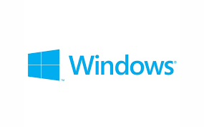

Examples of Operating Systems
4.0

Slide 6
Functions of OS
The primary purposes of an Operating System are to enable applications (softwares) to interact with a computer's hardware and to manage a system's hardware and software resources. To do this, it must perform the following functions:
Process Management
I/O Device Management
File Management
Network Management
Memory Management
Job Accounting
Storage Management
Resource Management
Security Management
Error Detection and Correction
Command Interpretation System
System Performance Control
4.0

Slide 7
Process Management
A process is a program or a part of a program that is run on a computer. It is loaded into the main memory, RAM and would need certain computer resources to carry out it’s functions such as CPU time and power, files, memory or I/O devices.
In a multi-programming environment, the OS would have the job of deciding the order in which processes would have access to the CPU, how much time each process would be allocated for processes. This is know as Process Scheduling
OS Process Management Activities:
Create, load, execute, suspend, resume, and terminate processes.
Switch system among multiple processes in main memory. Multi-tasking
Provides communication mechanisms for processes to communicate with each others
Provides synchronization mechanisms to control concurrent access to shared data to keep shared data consistent.
Allocate/de-allocate resources properly to prevent or avoid deadlock situation.
4.0

Slide 8
File Management
File management is one of the most important services of an operating system. A file system is organized into directories for efficient or easy navigation and usage. These directories may contain other directories and other files
An OS performs the following file management activities: File creation and deletion
Directory creation and deletion
The support of primitives for manipulating files and directories
Mapping files onto secondary storage
File backup on stable (nonvolatile) storage media
4.0

Slide 9
Device Management
An OS manages device communication via its respective drivers. It provides an abstract level of H/W devices and keep the details from applications to ensure proper use of devices, to prevent errors, and to provide users with convenient and efficient programming environment.
An OS performs the following I/O Device management activities:
Keeps track of all devices connected to the system. Designates a program responsible for every device known as the Input/Output controller.
Decide which process gets access to a certain device and for how long.
Allocates and Deallocate devices effectively and efficiently
An OS controls the working of multiple input-output devices on a computer system
It processes requests from devices and gives output/feedback back to the device
4.0

Slide 10
Network Management
This involves activities necessary for the management of connections between various computer systems connected to each other in a computer network.
An OS performs the following file management activities: Network administration
Network maintenance
Network operation
Network provisioning
Network security
Network Monitoring
4.0

Slide 11
Memory Management
The Primary memory or Main memory is made up of a large array of bytes or words where each byte or word is assigned a certain address. The main memory is fast storage and it can be accessed directly by the CPU.
For a program to be executed, it must first be loaded in the main memory. The allocation and deallocation of various processes to the main memory for execution is carried out by the OS. It also ensures that other processes do not consume the memory allocated to one process.
An Operating System performs the following activities for Memory Management:
It keeps track of primary memory, i.e., which bytes of memory are used by which user program. The memory addresses that have already been allocated and the memory addresses of the memory that has not yet been used.
In multiprogramming, the OS decides the order in which processes are granted memory access, and for how long.
It Allocates the memory to a process when the process requests it and deallocates the memory when the process has terminated or is performing an I/O operation.
4.0

Slide 12
Storage Management
Programs executed on a computer as well as the data they access, must be into the main memory during execution. Due to the fact that the main memory is often too small to permanently accommodate all data and program and to improve effieciency, the computer system must provide secondary storage to backup main memory.
Most modern computer systems use disks as the principle on-line storage medium, for both programs and data. Programs, like compilers, assemblers, sort routines, editors, formatters, and so on, are stored on the disk until loaded into memory, and then use the disk as both the source and destination of their processing.
The operating system is responsible for the following activities in connection with disk management:
Free space management
Storage allocation
Disk scheduling
4.0

Slide 13
Other OS Functions
An Operating System is a complex Software System. Apart from the above mentioned components and responsibilities, there are many other activities performed by the Operating System. Few of them are listed below:
Security − By means of password and similar other techniques, it prevents unauthorized access to programs and data.
Control over system performance − Recording delays between request for a service and response from the system.
Job accounting − Keeping track of time and resources used by various jobs and users.
Error detecting aids − Production of dumps, traces, error messages, and other debugging and error detecting aids.
Coordination between other softwares and users − Coordination and assignment of compilers, interpreters, assemblers and other software to the various users of the computer systems.
4.0

Slide 14
Types of OS
Batch Operating System
Time Sharing Operating System
Distributed Operating System
Network Operating System
Real-time Operating System
4.0

Slide 15
OS Services
1. Program Execution
Load Program into memory
Executes the program.
Handles program's execution.
Provides a mechanism for process synchronization.
Provides a mechanism for process communication.
Provides a mechanism for deadlock handling.
2. I/O Operation:
Provides access to files when required
Handles read and write operations
3. File system manipulation:
Program needs to read a file or write a file.
The operating system gives the permission to the program for operation on file.
Permission varies from read-only, read-write, denied and so on.
Operating System provides an interface to the user to create/delete files.
Operating System provides an interface to the user to create/delete directories.
Operating System provides an interface to create the backup of file system.
4.0

Slide 16
OS Services
4. Communication
Two processes often require data to be transferred between them
Both the processes can be on one computer or on different computers, but are connected through a computer network.
Communication may be implemented either by Shared Memory or by Message Passing.
5. Error handling:
The OS constantly checks for possible errors.
The OS takes an appropriate action to ensure correct and consistent computing.
6. Resource Management:
The OS manages all kinds of resources using schedulers.
CPU scheduling algorithms are used for better utilization of CPU.
7. Protection:
The OS ensures that all access to system resources is controlled.
The OS ensures that external I/O devices are protected from invalid access attempts.
The OS provides authentication features for each user by means of passwords.
4.0

Slide 17
Linux Operating System
Linux is an open-source operating system created by Linus Torvalds in 1991. It was designed to be like Linux, but due to its vibrant community and popularity, Linux has grown into a very powerful and popular operating system with so many flavors and distributions. It is used today in various hardware devices, computers, supercomputers, phones, IoT devices, and so many more machines.
Linux is made up of three major components:
The Kernel: This is the base component of the Linux operating system which is essential for its functioning. It manages system resources such as memory, process, and file management and also communicates with the hardware
System User Space: This is the component where system-level tasks like software installs and configurations are performed. It includes the shell, command-line, daemons and processes that run in the background
Applications: These include all the software installed on the operating system for performing various tasks and functions.
Popular Linux Distros:
Ubuntu, Debian
centOS, RHEL
Fedora, openSUSE
4.0

Slide 18
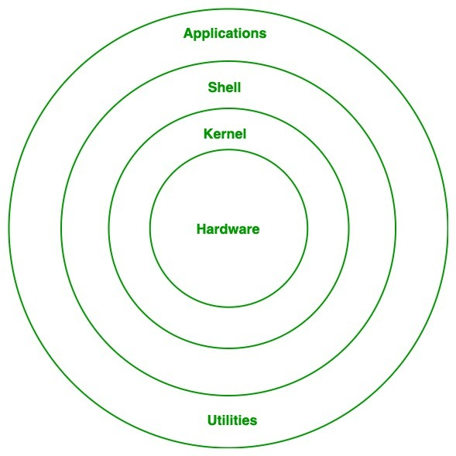
Linux Operating System Architecture
4.0

Slide 19
Linux Operating System Architecture
Kernel: Kernel is the core of the Linux based operating system. It virtualizes the common hardware resources of the computer to provide each process with its virtual resources. This makes the process seem as if it is the sole process running on the machine. The kernel is also responsible for preventing and mitigating conflicts between different processes.
System Library:Linux uses system libraries, also known as shared libraries, to implement various functionalities of the operating system. These libraries contain pre-written code that applications can use to perform specific tasks. By using these libraries, developers can save time and effort, as they don’t need to write the same code repeatedly. System libraries act as an interface between applications and the kernel, providing a standardized and efficient way for applications to interact with the underlying system.
Shell:The shell is the user interface of the Linux Operating System. It allows users to interact with the system by entering commands, which the shell interprets and executes. The shell serves as a bridge between the user and the kernel, forwarding the user’s requests to the kernel for processing. It provides a convenient way for users to perform various tasks, such as running programs, managing files, and configuring the system.
4.0

Slide 20
Linux Operating System Architecture
Hardware Layer: The hardware layer encompasses all the physical components of the computer, such as RAM (Random Access Memory), HDD (Hard Disk Drive), CPU (Central Processing Unit), and input/output devices. This layer is responsible for interacting with the Linux Operating System and providing the necessary resources for the system and applications to function properly. The Linux kernel and system libraries enable communication and control over these hardware components, ensuring that they work harmoniously together.
System Utility: System utilities are essential tools and programs provided by the Linux Operating System to manage and configure various aspects of the system. These utilities perform tasks such as installing software, configuring network settings, monitoring system performance, managing users and permissions, and much more. System utilities simplify system administration tasks, making it easier for users to maintain their Linux systems efficiently.
4.0

Slide 21
Linux Distribution
Linux distribution is an operating system that is made up of a collection of software based on Linux kernel or you can say distribution contains the Linux kernel and supporting libraries and software. And you can get Linux based operating system by downloading one of the Linux distributions and these distributions are available for different types of devices like embedded devices, personal computers, etc.
Around 600 + Linux Distributions are available and some of the popular Linux distributions are:
MX Linux
Manjaro
Linux Mint
elementary
Ubuntu
Debian
Solus
Fedora
openSUSE
RHEL
Kali Linux
Parrot OS
CentOS (approaching EOL)
Alpine
BlackArch
Raspberry PI OS
Amazon Linux 2
4.0

Slide 22
Basic Linux Commands
The most common way of interacting with a Linux system is using the command line or shell. Linux has a set of commands that are used to communicate with the kernel to perform actions on the system such as managing files, managing processes, handling system and application configurations and so much more
who
pwd
mkdir
touch
ls
cd
rm/rmdir
cp
mv
chmod/chown
man
history
4.0

Slide 23
Linux File System
A file system is collection on files which are located on the partition of a disk. The Linux file system in an important tool for managing, strong and retrieving the data on the disk effectively.
File Directories in Linux:
/boot: contains boot loader files
/etc: configuration files
/home: user home directory
/root: root home directory
/opt: third party applications
/dev: device files
/var: variable files
/usr: user applications
/bin: user binaries
/sbin: system binaries
/proc: process information
/mnt: mount directories
/sys: virtual file system
/media: removable devices
/run: temporary file system
/tmp: temporary files
/lib: system library
4.0

Slide 24
Questions?
4.0

Slide 25
THANK
YOU
Contact:
LinkedIn: Malchiel Urias
X (Formerly Twitter): @TheMalc_
4.0

